Slide 1
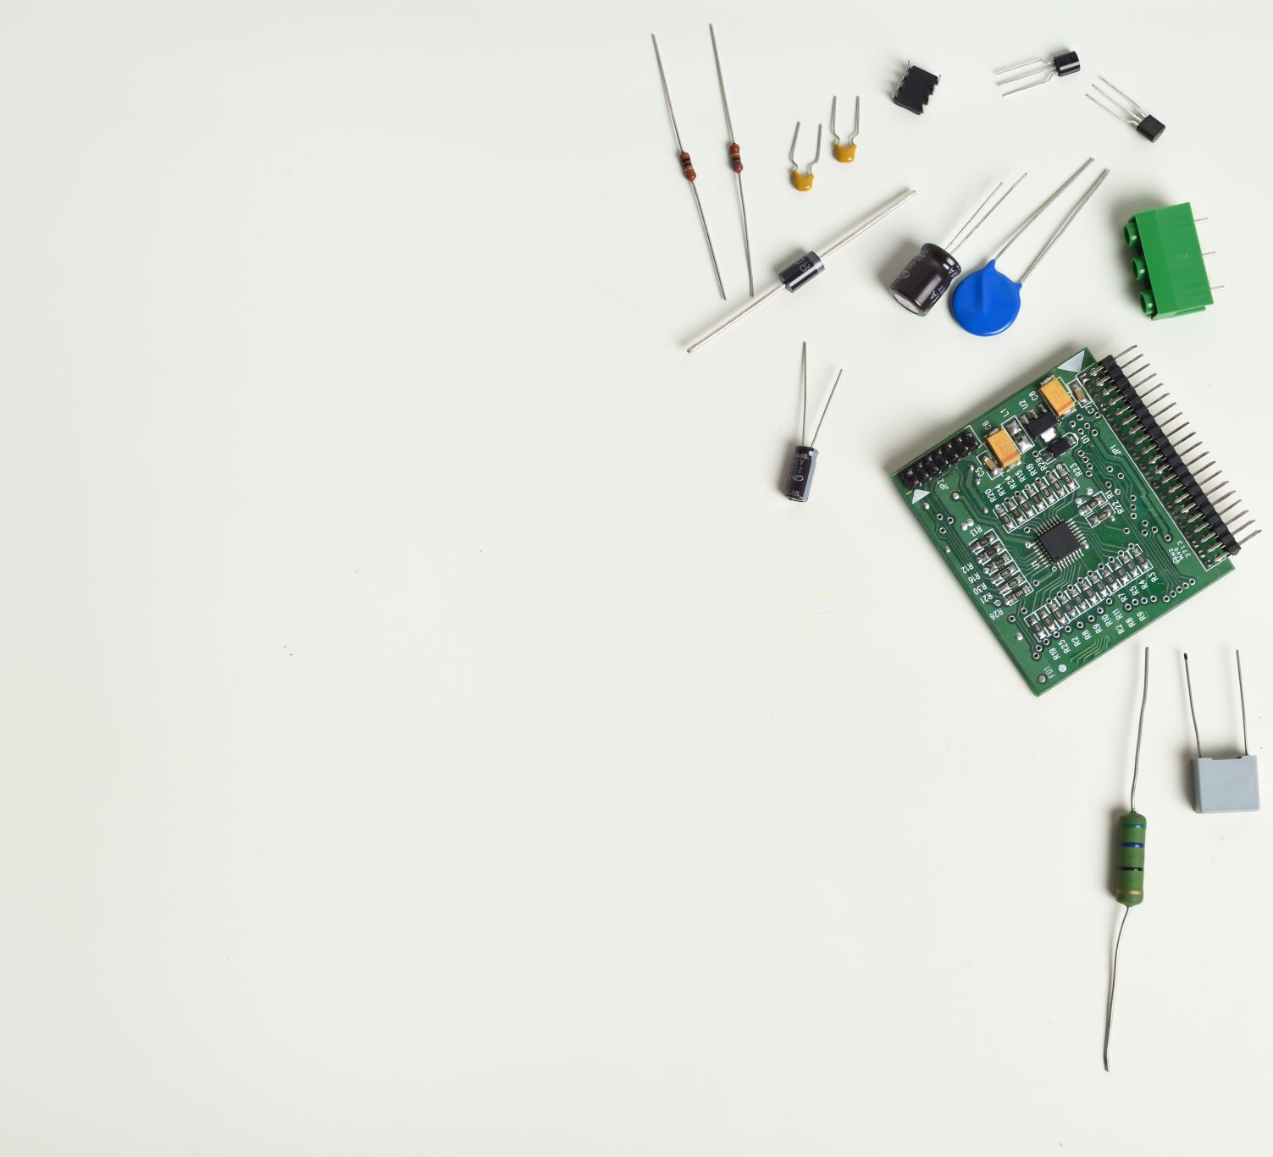
BATTERY-LESS IOT DEVICE SDDEC19-21
ADVISOR: DR. HENRY DUWE
CLIENTS: DR. NATHAN NEIHART
DR. DAJI QAIO
HTTP://SDDEC19-21.SD.ECE.IASTATE.EDU/
Notes:
Derek (chow)

Slide 2
MEMBER CONTRIBUTIONS
Antenna design and testing
Matthew Goetzman & Mohamed Gesalla
Power System & Rectifier design and testing
Derek Nash & Adithya Basnayake
Microcontroller functionality, communications, and testing
Mohammed Al-Mukhaini & Bradley Rhein
Website design/maintenance
Mohammed Al-Mukhaini & Derek Nash
Documentation
All members
Outreach/ meeting coordination
Mohammed Al-Mukhaini
Notes:
Derek
All follow

Slide 3
PROJECT PLAN

Slide 4
PROBLEM STATEMENT
General Problem statement:
General Solution Approach:
Harvest RF energy and convert it into a form useable by a microcontroller to perform a useful task
Harvest and convert ambient RF waves into DC
Gradual charge and storage (capacitor bank)
Low Power Mode Microcontroller
Performs a task (reads temperature)
Notes:
Mohammed M

Slide 5
FUNCTIONAL REQUIREMENTS
Energy Harvesting
Harvest RF signal from WiFi router
Power
Low voltage storage
Regulated Voltage supply to microcontroller
Rectifier
Rectified & Multiplied voltage ≥ 2.4 V
Embedded Systems
MSP430 microcontroller
Record temperature via internal ADC
Store and transmit data at a later time
Notes:
Derek

Slide 6
NON-FUNCTIONAL REQUIREMENTS
Portability
Reasonable size for Prototype
Compatible
Efficiency
Reasonable operation and charging time
Testability
Reliable for demonstration
Reasonable cost
Under $100
Notes:
Mohamed G
We were asked to develop a

Slide 7
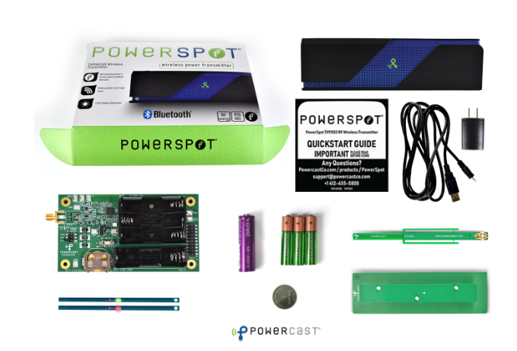
MARKET / LITERATURE SURVEY
Not many other manufacturers
Powerspot kit
https://www.powercastco.com/
Focus on harvesting
Not communicating
Huge Potential
Network for battery-less devices
Self-Sustaining
Remotely located
Dependable
Notes:
Matt

Slide 8
RESOURCE REQUIREMENTS
Notes:
Adi

Slide 9
POTENTIAL RISKS
Headache
Device Safety
ESD
Fall height
Public Safety
Device is above head height
Touching may induce a shock
Electric Shock
Electrostatic Discharge
Short Circuit
LOW RISK FACTOR
Notes:
Brad

Slide 10
SYSTEM DESIGN

Slide 11
FUNCTIONAL MODULES
Notes:
Bard

Slide 12
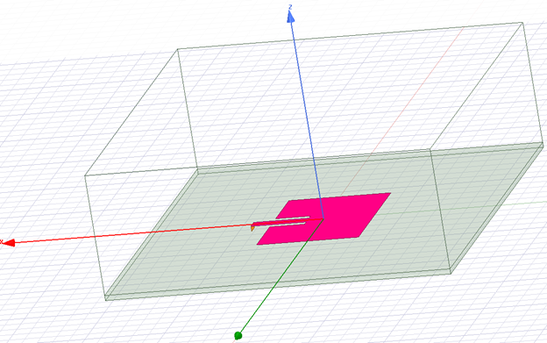
ANTENNA DEVELOPMENT
Patch Antenna radiating at 2.4GHz
Easy to manufacture, low-profile
Generating low power
Moderate antenna efficiency
Notes:
Mohamed G

Slide 13
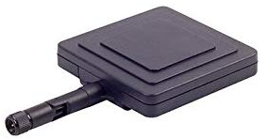
ANTENNA
2.4 GHz directional, high gain antenna
Designed to have a 50 Ohm characteristic impedance
Advertised characteristic response: 2350 - 2450 MHz
Gain of 8dBi
Max Power 50W
Notes:
Mohamed G

Slide 14
ANTENNA: CHALLENGES & SOLUTIONS
Finding a good design for what we need:
High gain while still having a sizeable beamwidth
Size
Preferable a design that can be oriented in different directions
Finding characteristic impedance that is already close to our rectifier input impedance.
Notes:
Mohamed G

Slide 15
IMPEDANCE MATCHING DEVELOPMENT
Parasitic models required to compensate for high frequency waves
Nonlinear diodes need to be impedance matched
S-Parameter measurement components not usable with our circuit
Target power efficiency may not be feasible no matter how well we match the circuit
Notes:
Matt

Slide 16
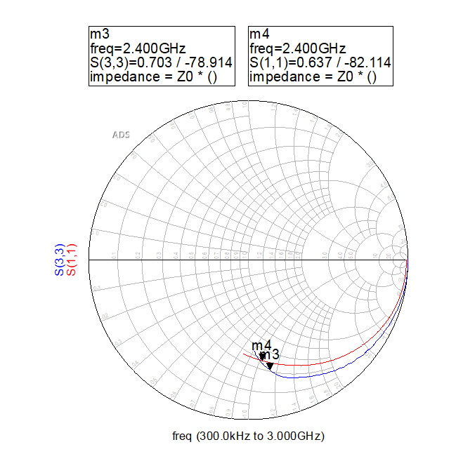
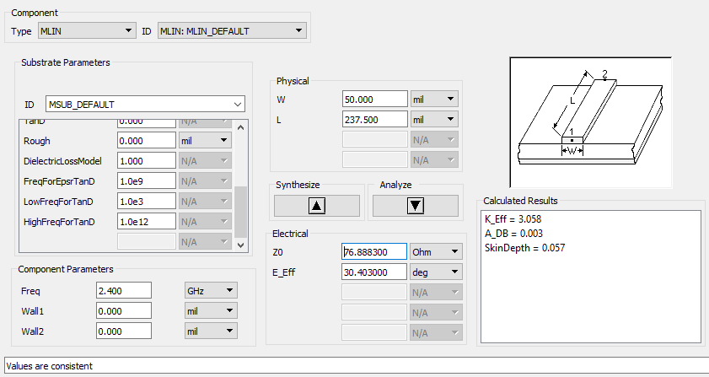
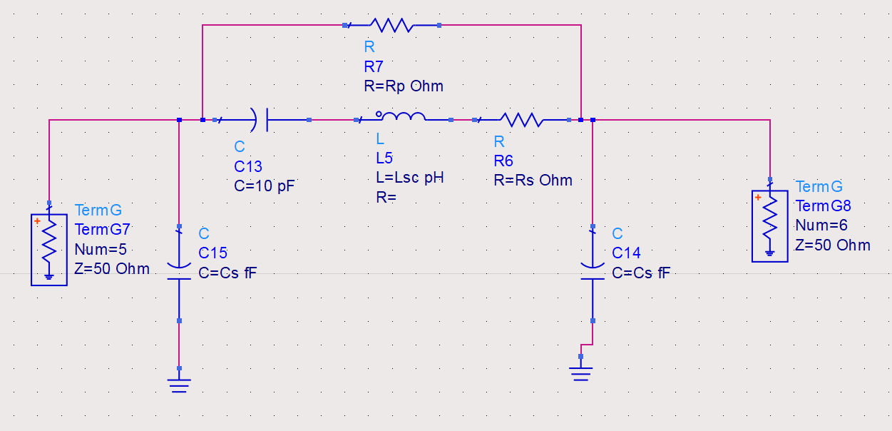
IMPEDANCE MATCHING TESTING
Notes:
Matt

Slide 17
IMPEDANCE MATCHING CHALLENGES
Unfamiliar with the method of analysis required
Diodes are nonlinear components that respond differently to changes in power supplied
Mistakes made with taking measurements that costed time
Notes:
Matt

Slide 18
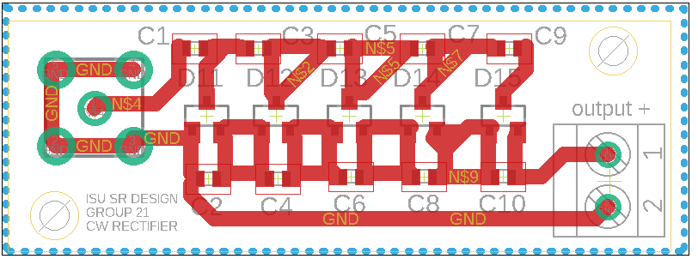
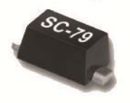
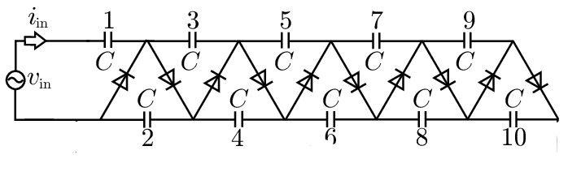
RECTIFIER AND MULTIPLIER
Cockcroft-Walton Voltage Multiplier (CW)
Rectify & Multiply
5-Stage multiplier
Primary Component
Schottky diode (Skyworks Schottky Diode SC-79)
Low forward voltage drop
Negligible leakage current
Notes:
Adi

Slide 19
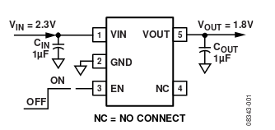
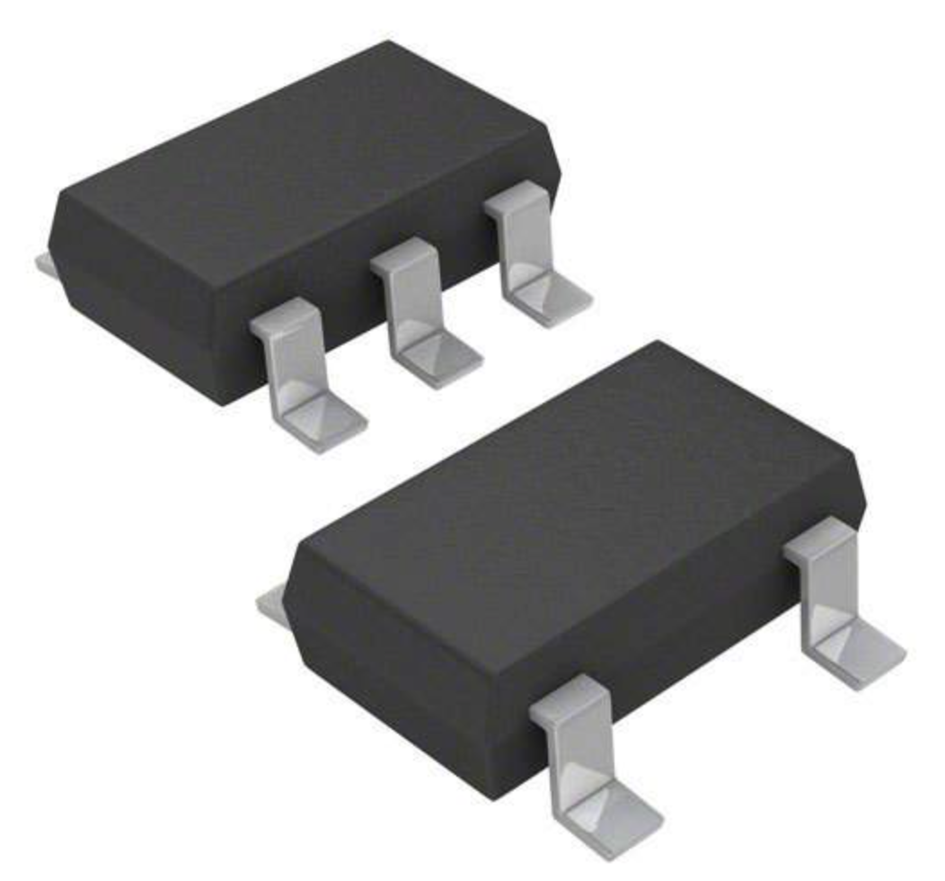
VOLTAGE REGULATOR
MSP430 microcontroller requires a steady DC voltage
>2.8V.
Linear Regulator
Linear voltage regulator IC: ADP150AUJZ-2.8-R7
Capacitors = 10uF
Notes:
Adi

Slide 20
POWER: CHALLENGES & SOLUTIONS
Low-amplitude input voltage wave
Multi-stage Cockroft-Walton rectifier
WiFi is not a perfect sine wave
Schottky diode on CW output for stability
Voltage on cap bank still somewhat variable
Used linear voltage regulator
Leakage current
Use lower capacitance, higher quality materials
Notes:
Derek

Slide 21
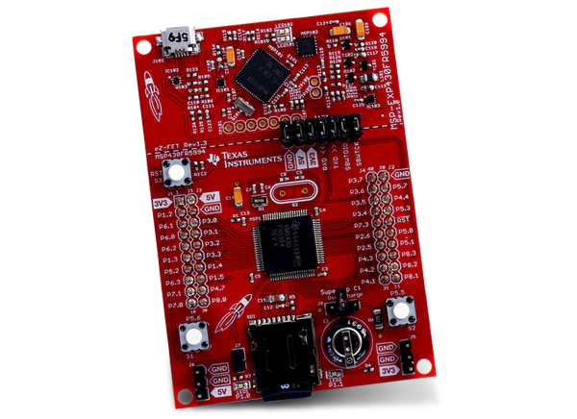
EMBEDDED SYSTEMS
MSP-EXP430FR5994
MSP430FR5994 MCU
256KB FRAM (non-volatile)
12-bit ADC
1.8V - 3.6V voltage range
Optimized Ultra-Low-Power Modes
Integrated USB Serial port
Supports EnergyTrace++ Technology
Notes:
Mohammed M

Slide 22
EMBEDDED SYSTEMS: CHALLENGES & SOLUTIONS
Serial Communication
Outputting temperature readings
Efficiency and Low Power Modes
Persistent C variables
Notes:
Brad

Slide 23
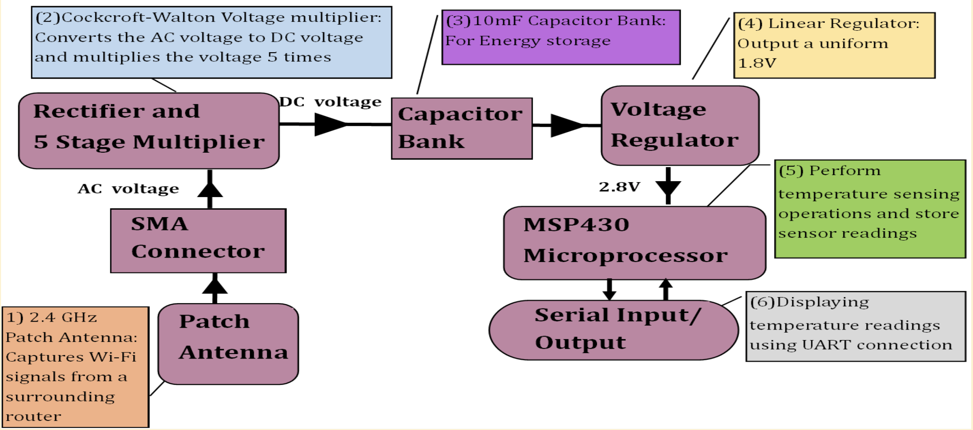
BUILDING BLOCK IMPLEMENTATION
Notes:
Adi

Slide 24
BUILDING BLOCK IMPLEMENTATION
Notes:
Brad

Slide 25
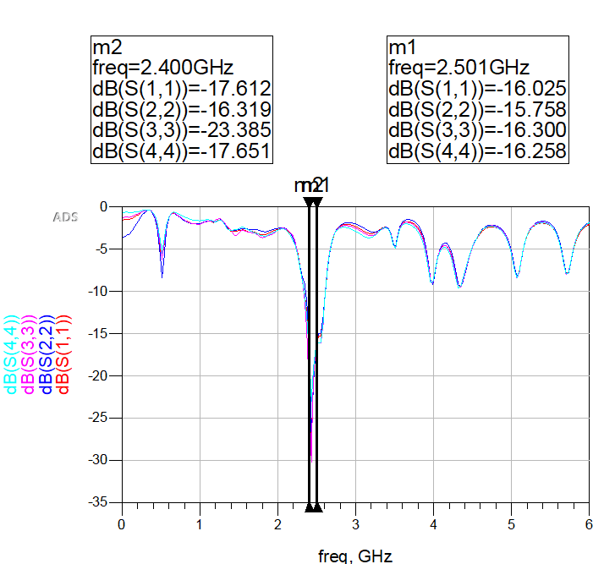
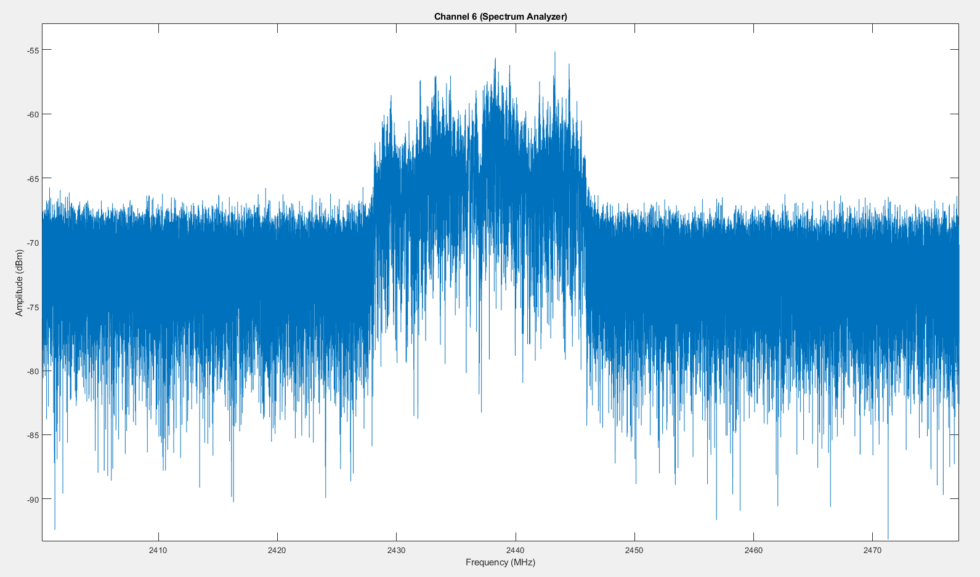
TESTING AND RESULTS: ANTENNA
Spectrum Analysis
S-parameters
Notes:
Matt

Slide 26
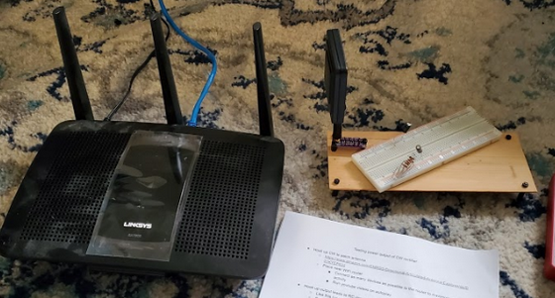
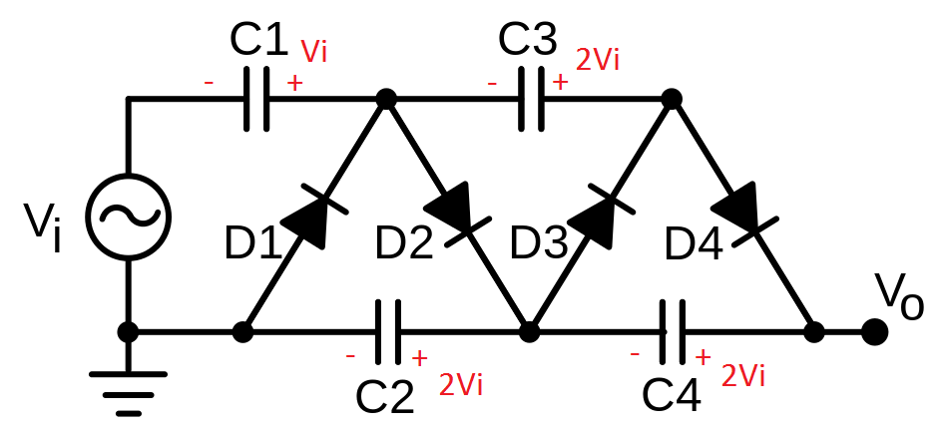
TESTING AND RESULTS: 5-STAGE VS 2-STAGE RECTIFIER
Purpose
Determine if # of stages affect the power output
Conditions
10uF capacitor
2 stage rectifier
5 stage rectifier
0.1 uF capacitor
2 stage rectifier
5 stage rectifier
Notes:
Derek

Slide 27
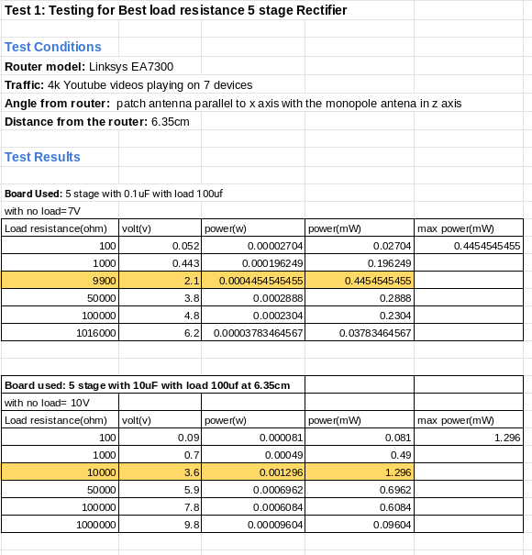
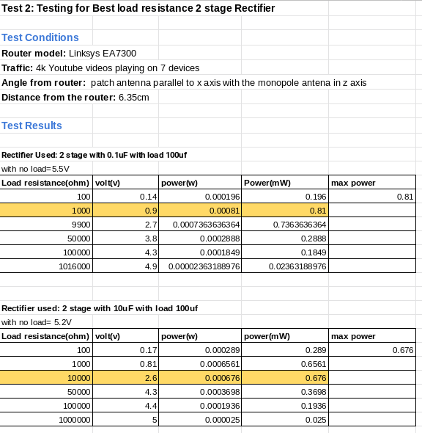
TESTING AND RESULTS: 5 STAGE VS 2 STAGE RECTIFIER
Notes:
Drerek

Slide 28
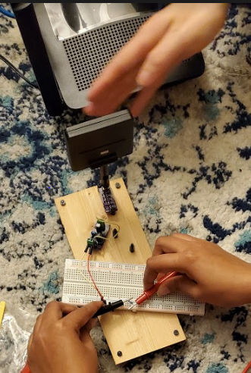
TESTING 5 STAGE RECTIFIER WITH THE VOLTAGE REGULATOR
Purpose
Determine final voltage output
If the voltage output from the regulator is steady
How long it takes for the capacitor bank to discharge
Notes:
Adi

Slide 29
TESTING 5 STAGE RECTIFIER WITH THE VOLTAGE REGULATOR
Notes:
Adi

Slide 30
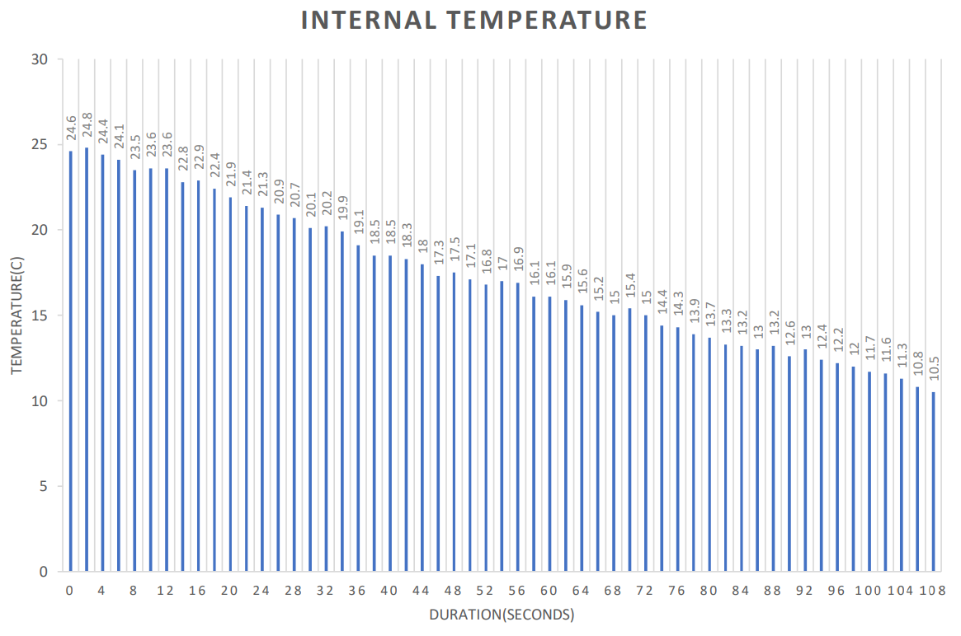
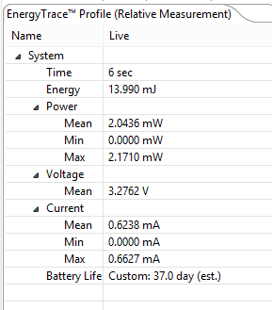
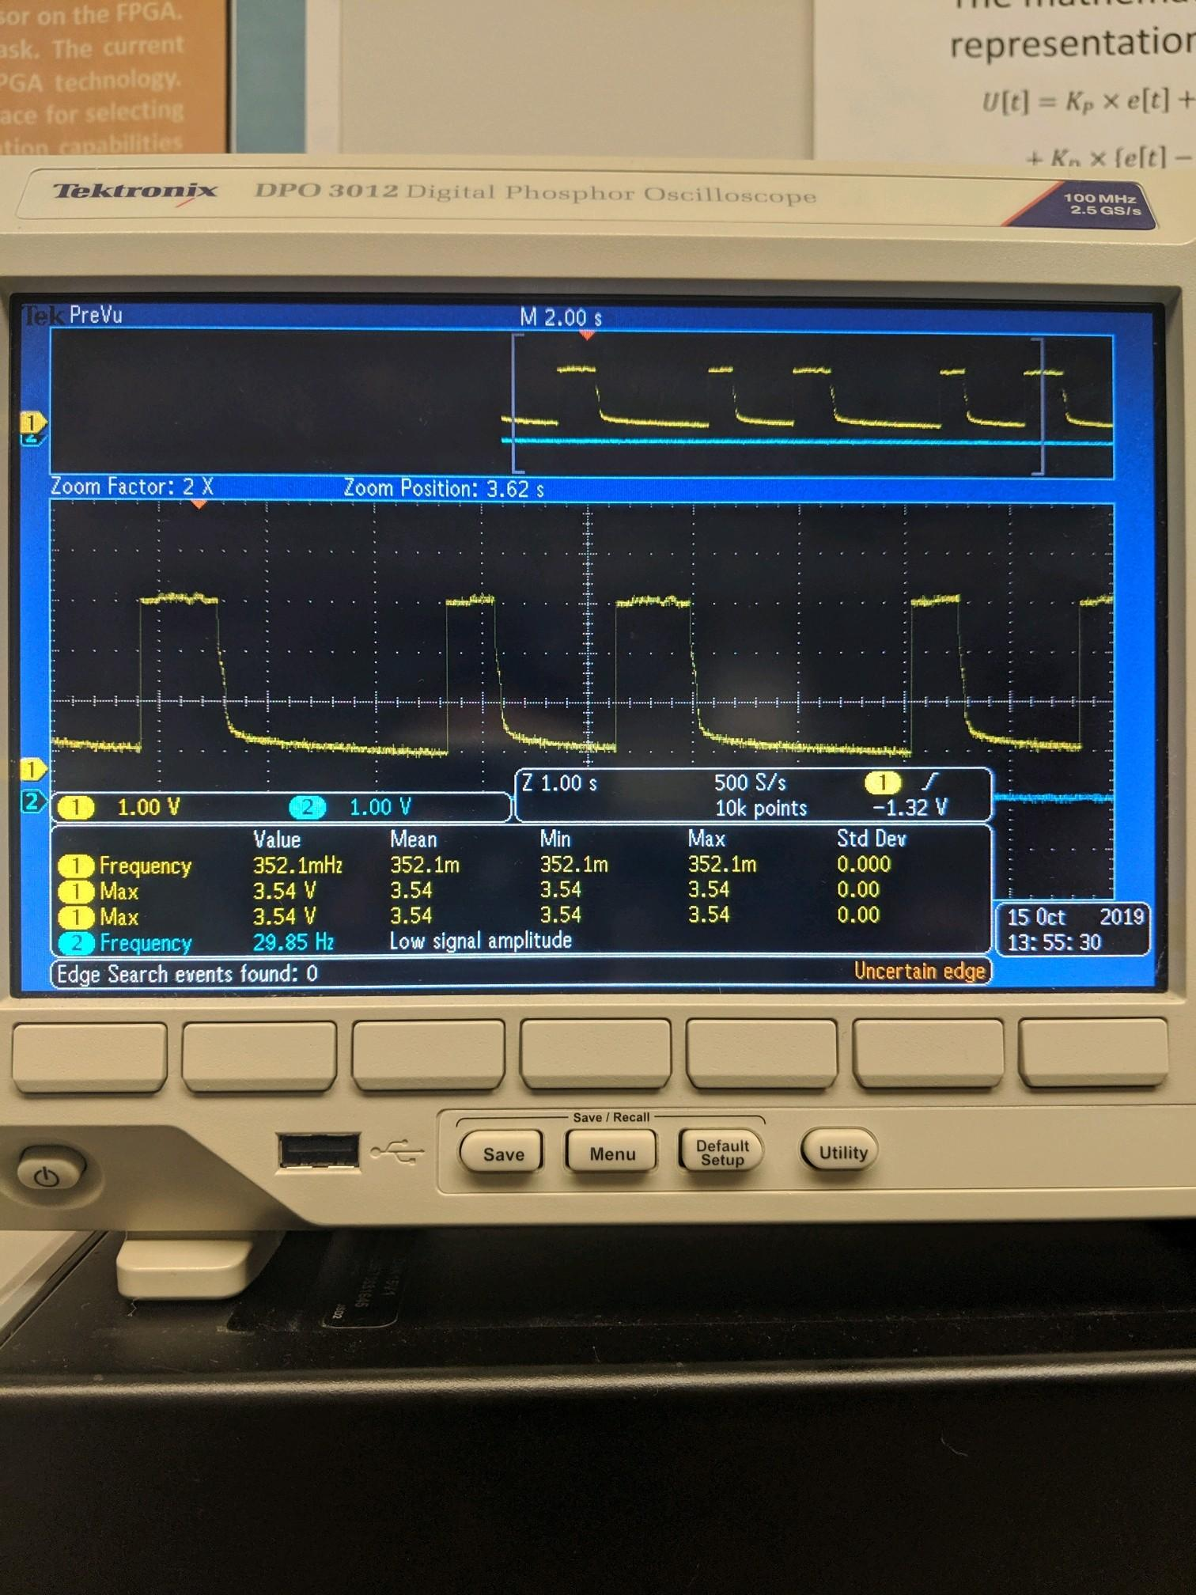
EMBEDDED SYSTEMS: CHALLENGES & SOLUTIONS
Accurate temperature readings Efficient energy consumption Power Mode and Current Demand
Notes:
Mohammed M

Slide 31
DEMO

Slide 32
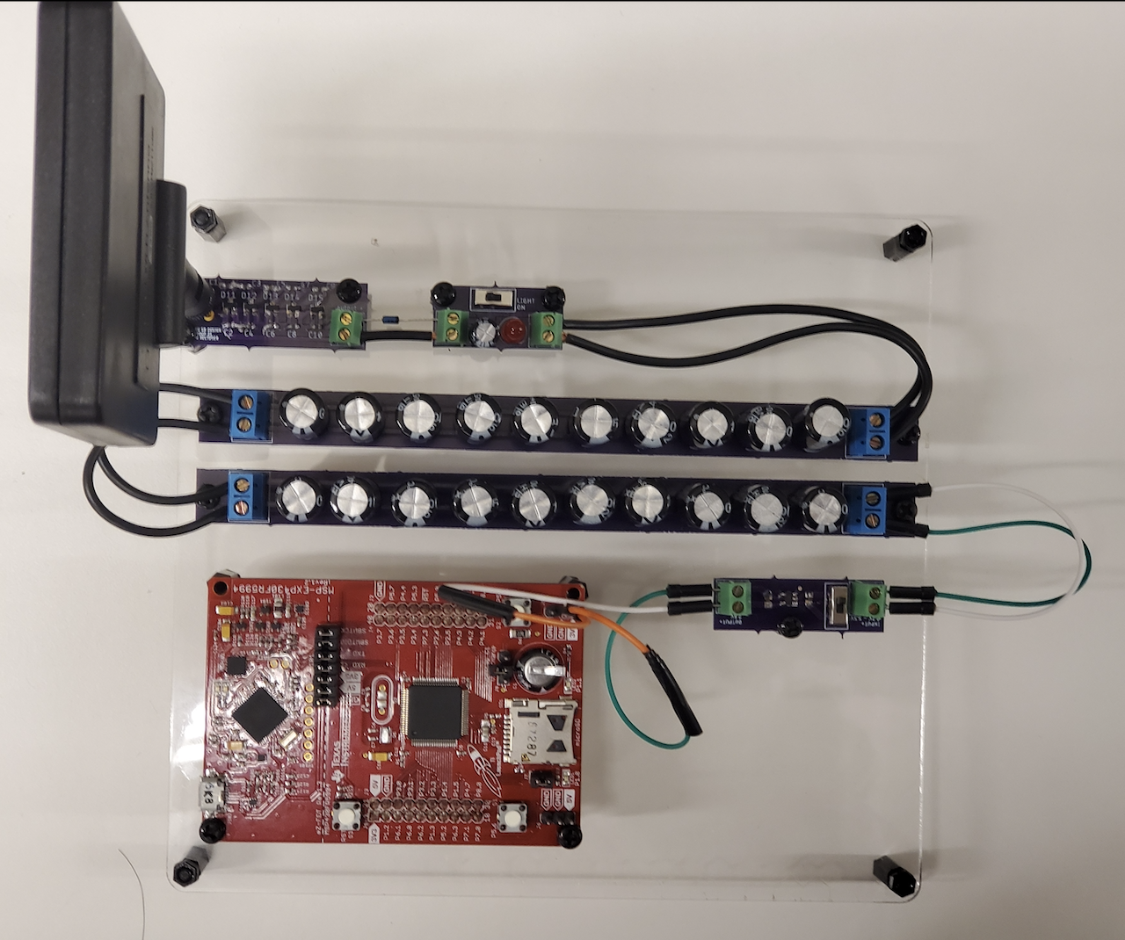
FINAL DESIGN
Fig: Final model with 100uF capacitor bank
Fig: Final model with 20mF capacitor bank
Notes:
Derek

Slide 33
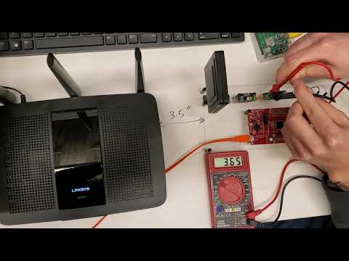
DEMO VIDEO
https://youtu.be/ghB6WJD2FEI
Notes:
Derek and Brad

Slide 34
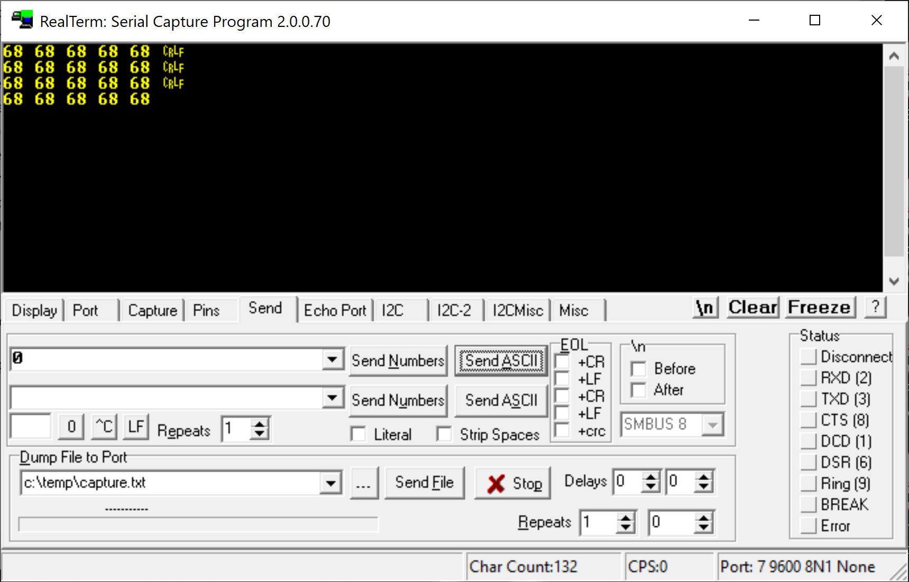
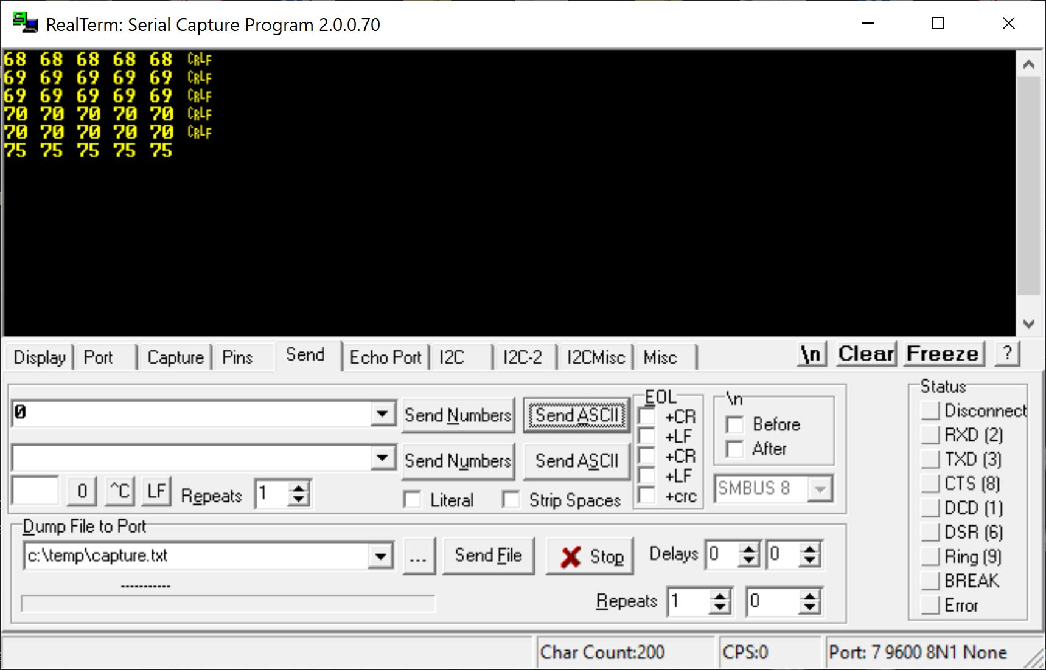
DEMO VIDEO - RESULTS
At room temperature Warming up
All temperatures in degrees Farenheit.
Notes:
Brad

Slide 35
CONCLUSION

Slide 36
LESSONS LEARNED
Minimum voltage for operating MSP430 is 3.0V
Check for commercial alternatives prior to committing to a design
Ground planes are easy improvements to PCBs
Inrush current can kill voltage regulators
Schottky diodes are linear in the forward region
Notes:
Adi

Slide 37
CLIENT FEEDBACK
Get measurements/test as early as possible
Larger capacitor bank is worth the added leakage current
It’s OK to buy antenna instead of designing it
Integrate a voltage regulator IC
Met the portability requirement
Understand delay times with ordering parts/supplies
Notes:
Mohamed G

Slide 38
IMPROVEMENTS
Adding impedance matching circuit for better efficiency
Change code design so that MCU can run under constant power
Adding a voltage supervisor in between the capacitor bank and the voltage regulator
Notes:
Derek

Slide 39
QUESTIONS?

